Slide 1



SoI Architecture Group
03 Aug 2017

Slide 2
Agenda
Group Description
Group Objectives
Group Accomplishments
Lessons Learned
Recommended Future Directions

Slide 3










Group Description
Primary goal: Develop a formal architecture for UxAS in an assume/guarantee framework
Team Members
Sean Regisford – AFRL
Aaron Fifarek – LinQuest (LQ)/AFRL
Brian Hulbert – LinQuest (LQ)/AFRL
Jen Davis – Rockwell Collins (RC)
Chris Elliott – Lockheed Martin (LM)
Ratnesh Kumar – Iowa State University (ISU)
Cat McGhan – University of Cincinnati (UC)
Paul Meng – GE
Hao Ren – Honeywell (H)
Ben Rodes – Dependable Computing (DC)
Han Yu – GE

Slide 4
Group Objectives
Develop a formal architecture for the current state of UxAS in an assume/guarantee framework
Identify strengths, weaknesses, and problems for the current architecture
Document decisions made along the way with supporting rationale
Make / begin to implement a revised formal architecture to mitigate challenges
(Non-objective) We did NOT attempt to prove that the component contracts are true for the existing C++ code for UxAS.
Notes:
Wanted to formalize UxAS to enable analysis
Found issues along the way. Fixed some.
Gave us insights.
To do this, we needed to capture contracts for the components in a formal language.

Slide 5
Group Accomplishments
REMOVE (If keeping next slide)
Extracted data types, input and output ports, and connections from code into both AADL/AGREE and ASSERT (LQ/AFRL, GE, RC)
Created formal contracts for eight services and tasks based on the OpenUxAS Wiki and conversations with the developer (DC, RC)
Stated and analyzed properties of these component-level contracts (DC, RC)
Idioms and lemmas developed and documented for effective use of AGREE (DC, RC)
Developed tool to compose component contracts into a system contract (H, ISU)
Added support for timing with finite history (i.e., “previous”)
Created an assurance argument for state machine correctness (DC)
Abstraction of task service finite state machine for simulation and formal analysis (LM)
Connected UxAS to the Robot Operating System (ROS) (UC)
All related?
How important do we want this to be
How important do we want this to be

Slide 6
Group Accomplishments
Extracted data types, input and output ports, and connections from code into both AADL/AGREE and ASSERT (LQ/AFRL, GE, RC)
Formalization in AADL/AGREE :
Created formal contracts for eight services and tasks based on the OpenUxAS Wiki and conversations with the developer (DC, RC)
Stated and analyzed properties of these component-level contracts including timing aspects (DC, RC, LQ)
Idioms and lemmas developed and documented for effective use of AGREE (DC, RC)
Formalization in ASSERT:
Created an ontology of the system (GE)
Examined contractual obligations of a representative component (GE)
Enhanced tool to compose component contracts in AGREE into a system contract (H, ISU)
Created an assurance argument for state machine correctness (DC)
Abstracted a task service finite state machine in Stateflow for simulation and formal analysis (LM)
Connected UxAS to the Robot Operating System (ROS) (UC)
Notes:
Composing contracts:
Added support for timing with finite history (i.e., “previous”)

Slide 7
Developing the UxAS Formal Representation

Slide 8
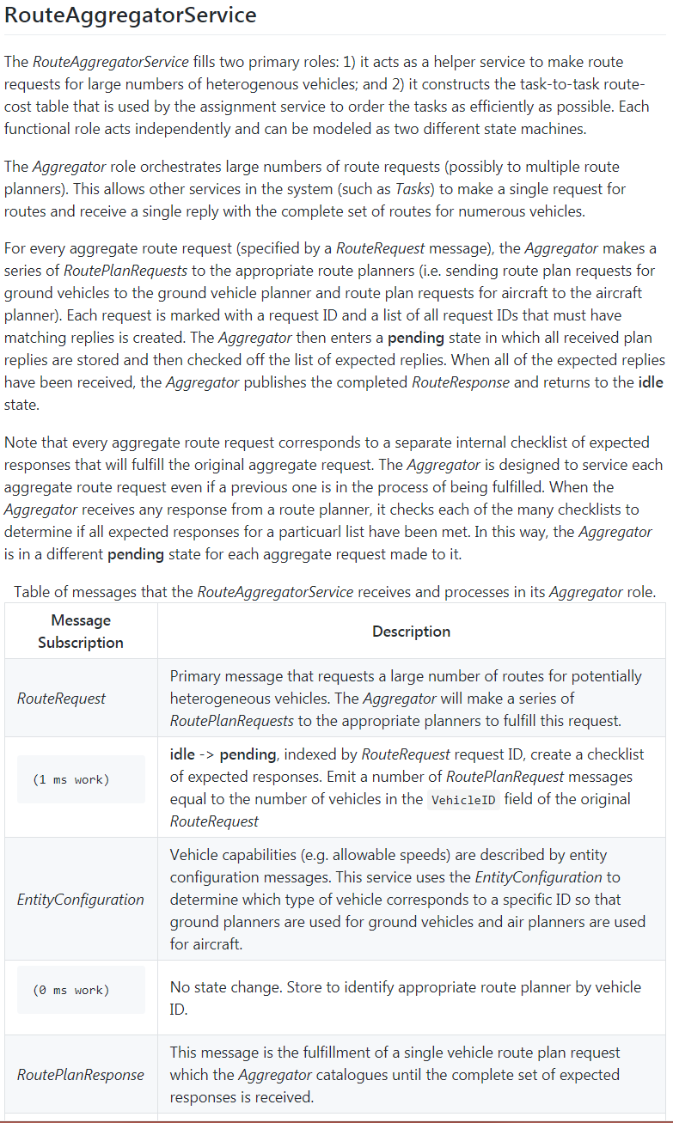
Producing the Formal Architecture
The formal architecture relied on the documentation that was found on the UxAS Wiki page.
Direct code decomposition was going to be too intensive to meet objectives efficiently.
Through formalization, gaps were identified.
Team members and SMEs exposed:
Behavior that was not desired
Design decisions that gave components similar but different roles
Clarification on how components were envisioned to work but currently do not
Just the effort to formalize components proved extremely valuable to the SMEs, even before the analysis.

Slide 9
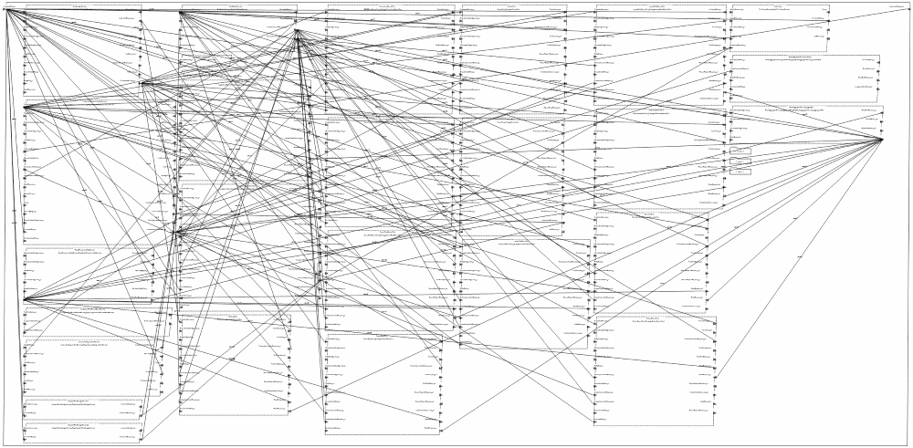
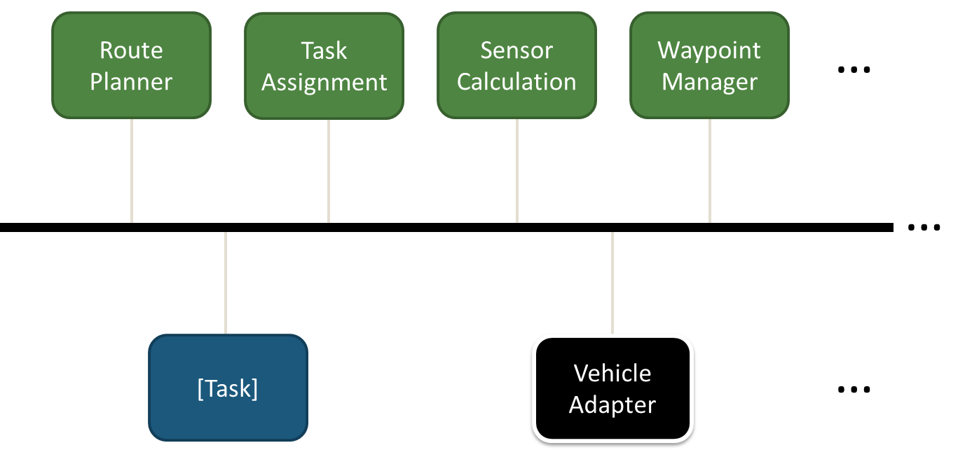
Formalization in AADL/AGREE Formalize Services
Authored a script to extract data types, input/output ports, and connections from code
Abstracted the common message bus by direct port connections
The structural representation of the Waterways mission is nearly complete
Created formal contracts (captured behaviors) for eight services and tasks based on the OpenUxAS Wiki and conversations with the lead developer
Waterways system level AADL connections diagram

Slide 10

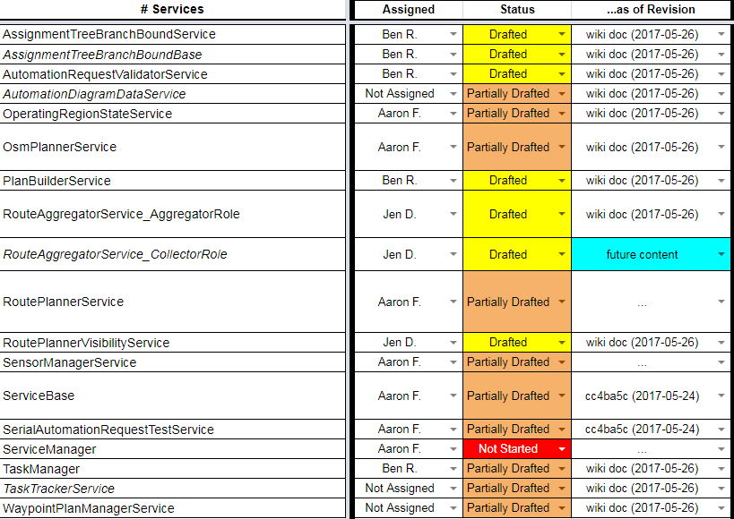
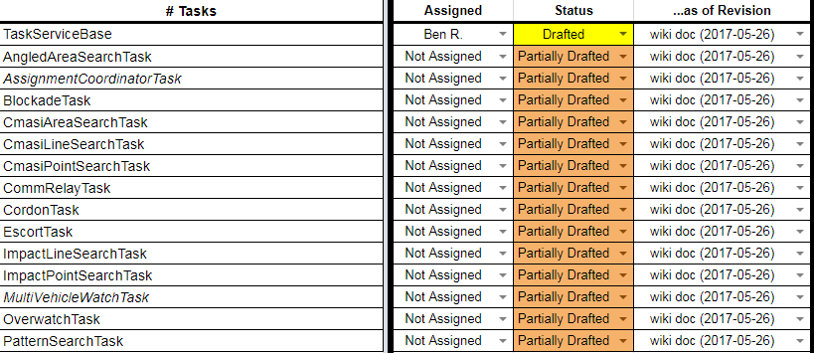
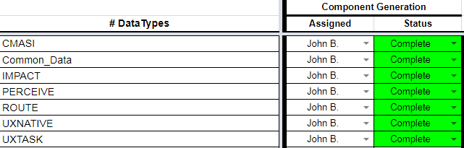
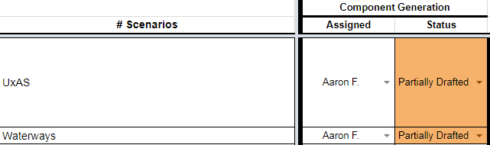
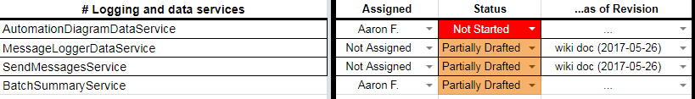
Formalization in AADL/AGREE UxAS Formal Model Status
Add legible headers for all sections
What happened to the communication services?

Slide 11

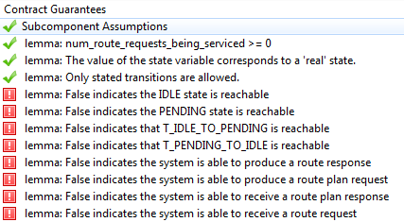
Formalization in AADL/AGREE What Did We Prove?
Realizability—check that a component implementation is possible and that there are no conflicts amongst the guarantees in the component’s contract
Assume/guarantee reasoning—check higher-level guarantees and lemmas using the guarantees of the subcomponents, and check that the assumptions of the subcomponents hold
Check that all input/output events are possible
Capture response times in components and analysis system-level response times
Analyze behavior of state machines that represent component behavior
Some analysis results for the Route Aggregator Service
(AggregatorRole):
Notes:
Consider adding or replacing with a screenshot of a Waterways timing guarantee

Slide 12
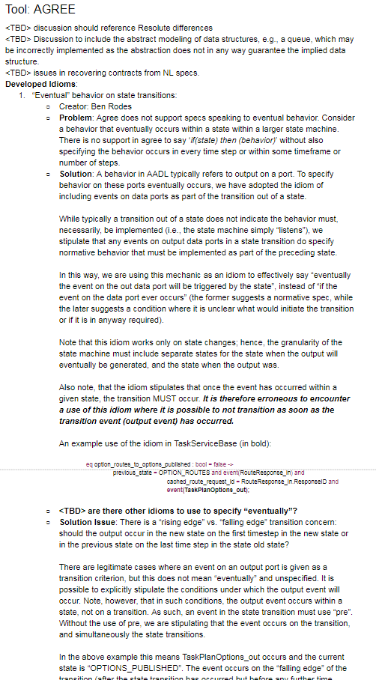
Formalization in AADL/AGREE What Did We Learn?
Idioms and lemmas developed and documented for effective use of AGREE
“Eventual” behavior on state transitions
Tracking and maintaining IDs
Dummy parent components for proving lemmas
Preventing inadvertent solutions space constraints
Abstraction of complex data structures
Skolemization idea for arrays
Fully specifying output event conditions
Use of AGREE connections
Real-time patterns

Slide 13

Formalization in ASSERT Proposed Approach
Extract architecture information through reverse engineering.
Transform extracted architecture information into SADL ontology.
Import SADL ontology into ASSERT™ to enable requirement capture, analysis, and test generation in ASSERT™
Software Codebase
(C, C++, Java, C#, Python, Ada, …)
Reverse Engineering
Software Design Information
Architecture Information Extraction
Architecture & Ontology Mapping Template
Automated Ontology Generation
Ontology Model
ASSERT™ SADL Ontology files
(.sadl files)
*SADL: Semantic Application Design Language

Slide 14
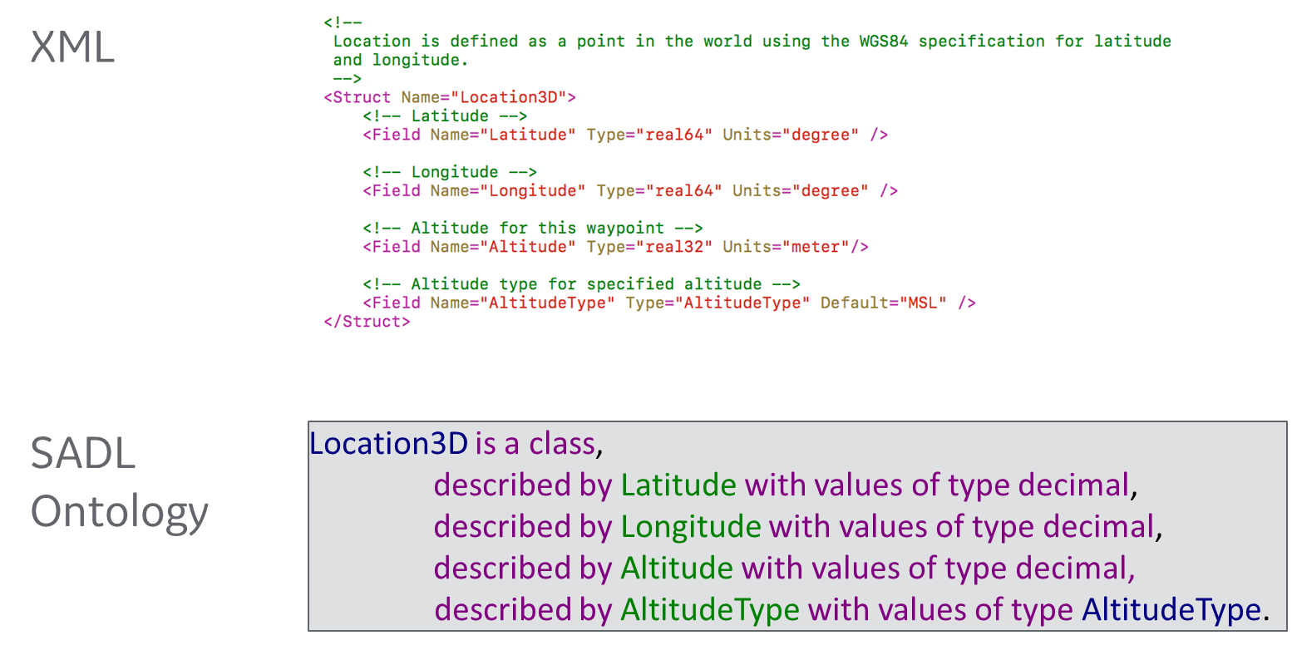
Formalization in ASSERT Modeling Message Type Definition in SADL Ontology

Slide 15
Formalization in ASSERT Modeling Dataflow in SADL Ontology
Illustrative Example in SADL Ontology
Context:
TaskAssignmentSummary__Subscription of PlanBuilderService is TaskAssignmentSummary_out of AssignmentTreeBranchBoundBase
and
TaskImplementationRequest__Subscription of TaskServiceBase is TaskImplementationRequest_out of PlanBuilderService
and
…
AssignmentTreeBranchBoundBase
TaskAssignmentSummary_out
PlanBuilderService
TaskImplementationRequest_out
TaskAssignmentSummary_Subscription
TaskServiceBase
TaskImplementationRequest_Subscription

Slide 16
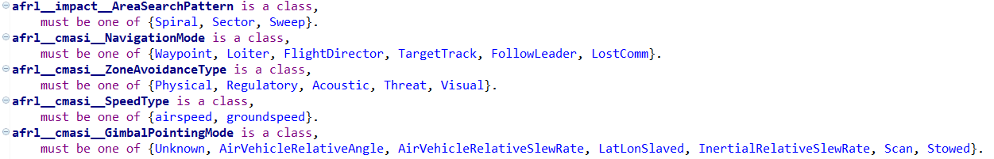
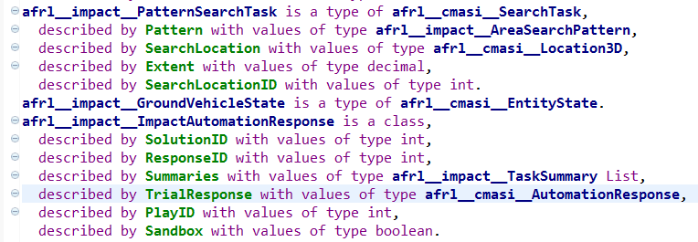
Formalization in ASSERT Modeling Data types and Variable Declarations in SADL Ontology
Snapshot of SADL Ontology Representation of AFRL UxAS Data Type
Snapshot of SADL Ontology Representation of AFRL UxAS Data Type
Data types of AFRL UxAS source code represented in SADL ontology

Slide 17
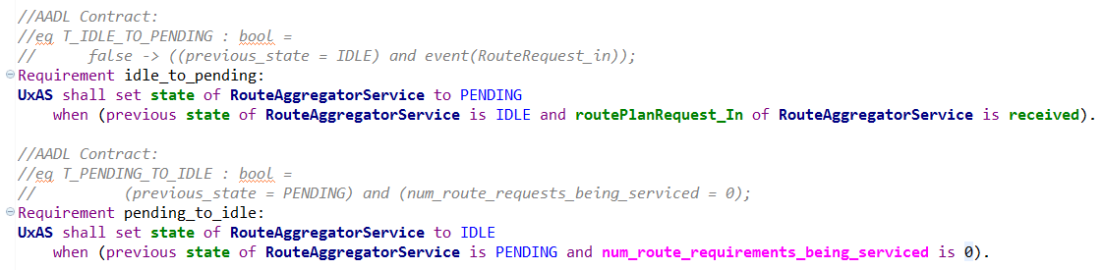
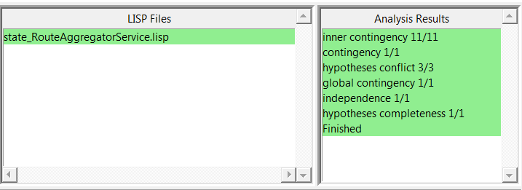
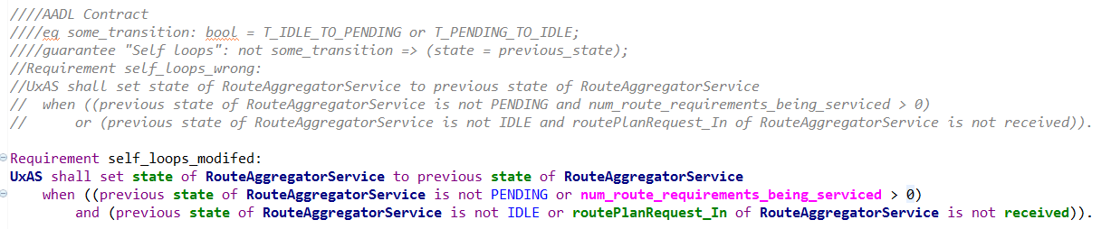
Formalization in ASSERT Illustrative example: Modified AADL Contracts Pass Analysis
What we learned: errors introduced in the manual contracts/requirements capturing process can be found earlier through automated analysis.

Slide 18
Impact of Formalization on UxAS
Recognition of key assumptions
IDs are unique (not guaranteed by the implementation today)
Illumination of design flaws
Missing ID checks
All services need to use the Route Planner for routes to ensure there is no conflict with an airspace constraint
Restructuring to avoid redundant or problematic logic
Split RouteAggregatorService into two services for two functional roles
Removal of some dead code in the Route Planner

Slide 19
State Machine Reasoning

Slide 20
State Machine Correctness Argument
Argument pattern for individual AADL component state machine correctness:
Structure repeated for each component
Vision: Situated within a larger model correctness argument
Argument situates proposed AGREE lemmas:
Purpose
Rationale
Limitations and benefits

Slide 21
Argument-Derived Observations
Best practices/standards for AADL/AGREE use are needed
Situate proofs within modeling fault analysis/mitigation
Supports arguments that the set of lemmas are complete and correct
Additional tool support to reduce human error
E.g., lemmas and repetitive infrastructure are developed manually
Minimize repetitive concerns in the argument about human error
Enhanced integration between AADL and AGREE
Minimize repetitive arguments about AADL and AGREE consistency/agreement
A simpler higher-level protocol state machine spec for validation
Provide a structure to validate against
Simplify validation activity and simplify validation arguments

Slide 22
Stateflow Representation
Benefits
Enable simulation
Enable analysis from Simulink
Qvtrace
Simulink-to-PVS
Simulink Design Verifier
Visualize counterexamples
Created a Stateflow representation of the Task Service Base state machine
Simulink/Stateflow Abstractions cross-checked with AADL model
Iterations required on all fronts
Tools complemented rapid improvement in abstractions
Found erroneous initial conditions, unused from/goto flags, and incorrect settings on if-else cases in Stateflow model

Slide 32
Lessons Learned
Many problems are identified through the process of formalization, before analysis
Data types (or an ontology), ports, and connections can be automatically extracted from code (with some moderate up front work)
Reusable (template) properties help find common mistakes
Not every error can be detected with a template property--a review of the specification itself is still worthwhile
Assurance arguments are useful to capture the “rest of the story”
SpeAR, ASSERT, AADL/AGREE, and QVtrace are all very capable analysis tools. There are synergies between them.
Challenges: arrays, inheritance
Notes:
Assurance arguments:
Differences between the model and the real world
Specification versus intent
Enhancements to the formal analysis tools could simplify the argument

Slide 33
Recommended Future Directions
Write contracts for the remaining thirty-two components
State and analyze system-level properties (in progress)
Generate code from AADL
Generate test cases from AGREE and run on UxAS implementation
Continue documenting decisions and the assurance case for the architecture
Notes:
Discuss: Model of Heterogeneous System (Distributed Mission-Task-Autopilot Management-Dubin)

Slide 34
Backup

Slide 35
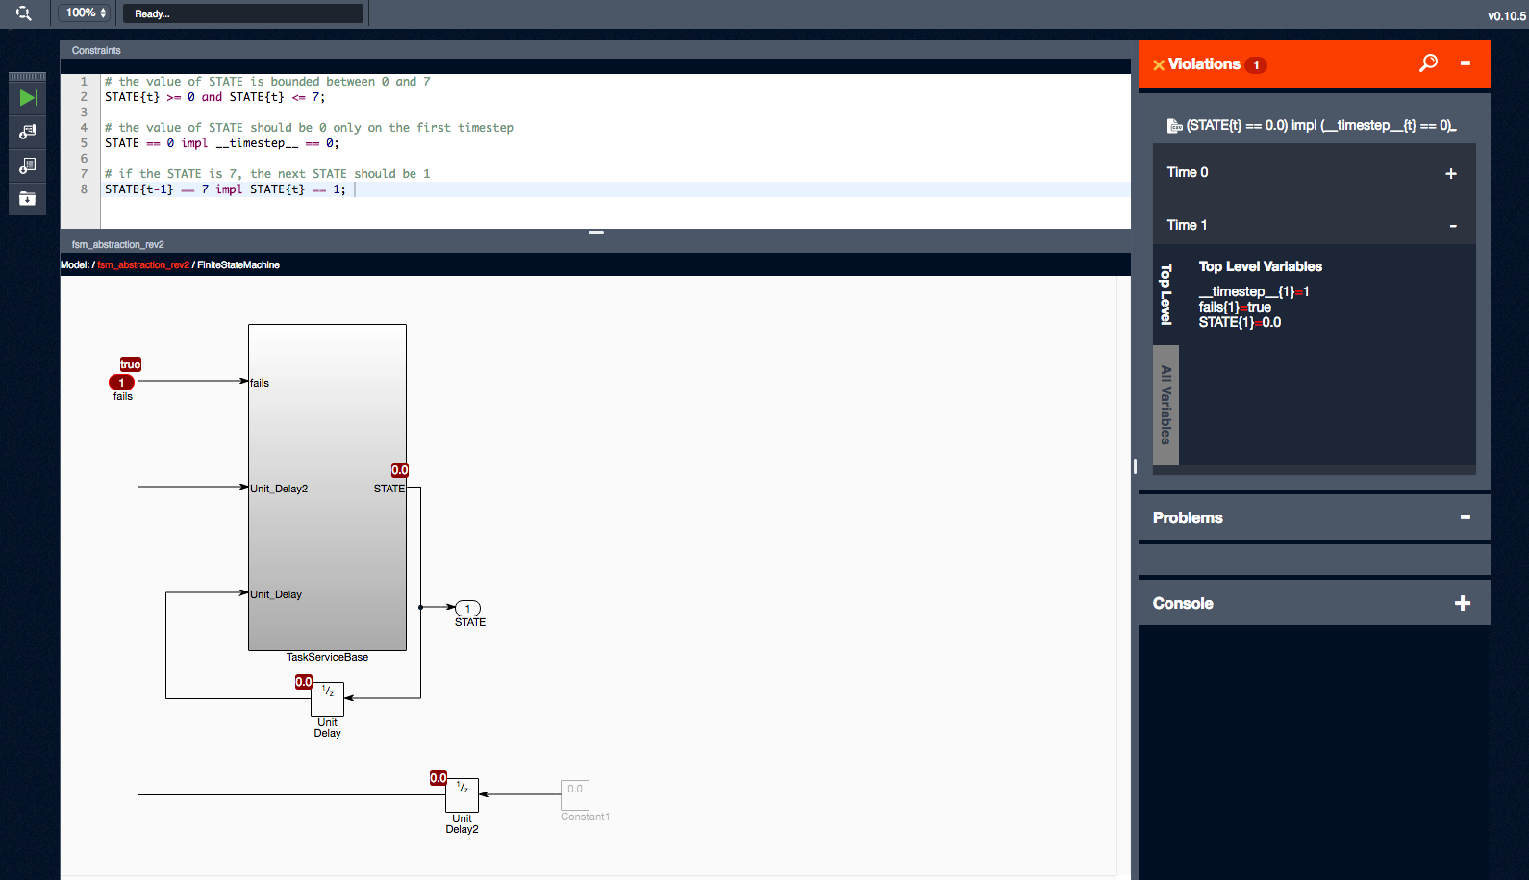
Analysis with QVtrace
Matlab Simulink Construction for Simulation → Qvtrace
What did we find?

